Slide 1
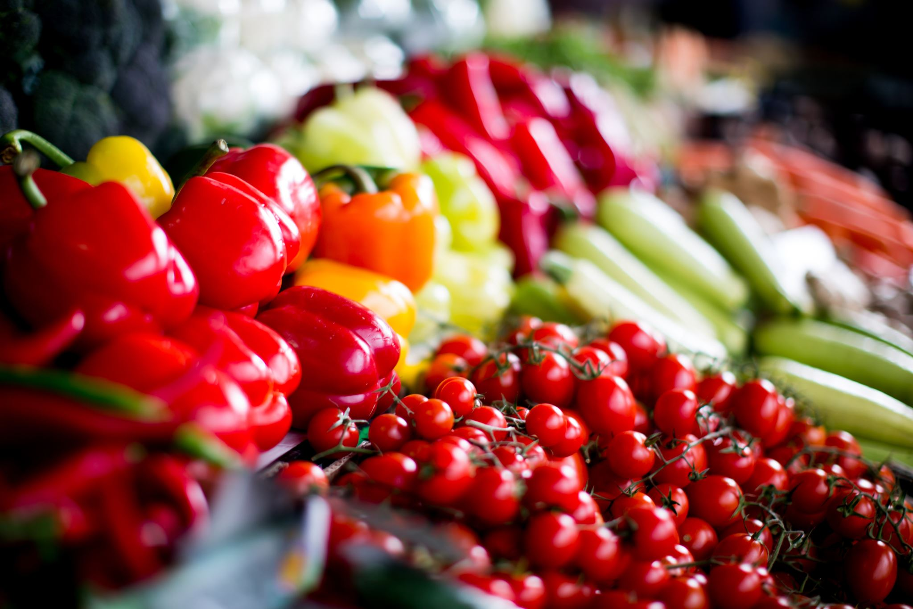


CookingTime: Recipe and Multi-timer App
By Natasja Hopkin, 18121344
Notes:
Hi, I’m Natasja Hopkin. I’m presenting my Mobile & Wearable Application project.

Slide 2
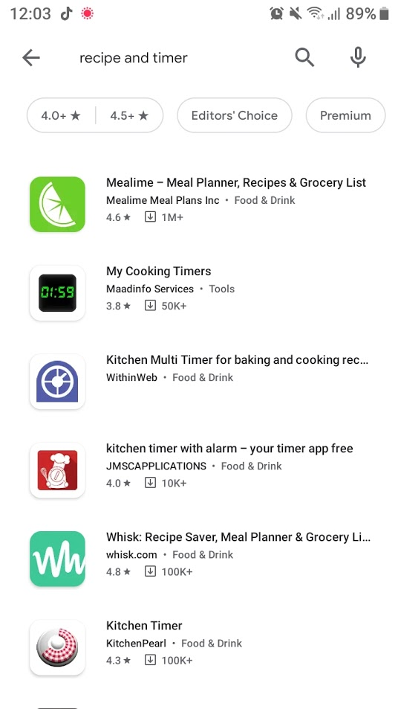
Problem
In a search for “recipe and timer”, results are all separate recipe/meal planner or timer apps
Notes:
Both recipe and timer apps exist, but as seen here: a search on the play store for a recipe and timer app produces either meal planning OR kitchen multitimers.

Slide 3
App Solution: CookingTime (working title) A single app where users can:
Create accounts
With specific food requirements (vegan, gluten free, allergies, or even just preference)
Search for and create recipes
Checked against food requirements
Alternate ingredients suggested for problem foods
Start timer
Generated multi-timers for recipes to cook and bake with stress-free precision
Save recipes
Browse and save recipes to a personalisable digital cookbook
Notes:
I intend to produce CookingTime, and app where users can find or create recipes, and have multi-timers generated according to those recipes. For a simple example – when cooking a pasta that takes 10 minutes and sauce that takes 3, the timer will remind the user after 7 minutes after the sauce. This can then scale up, with more complicated recipes – say a roast with many different vegetables.

Slide 4
Internal Design - UML
Notes:
Internal Designs

Slide 5
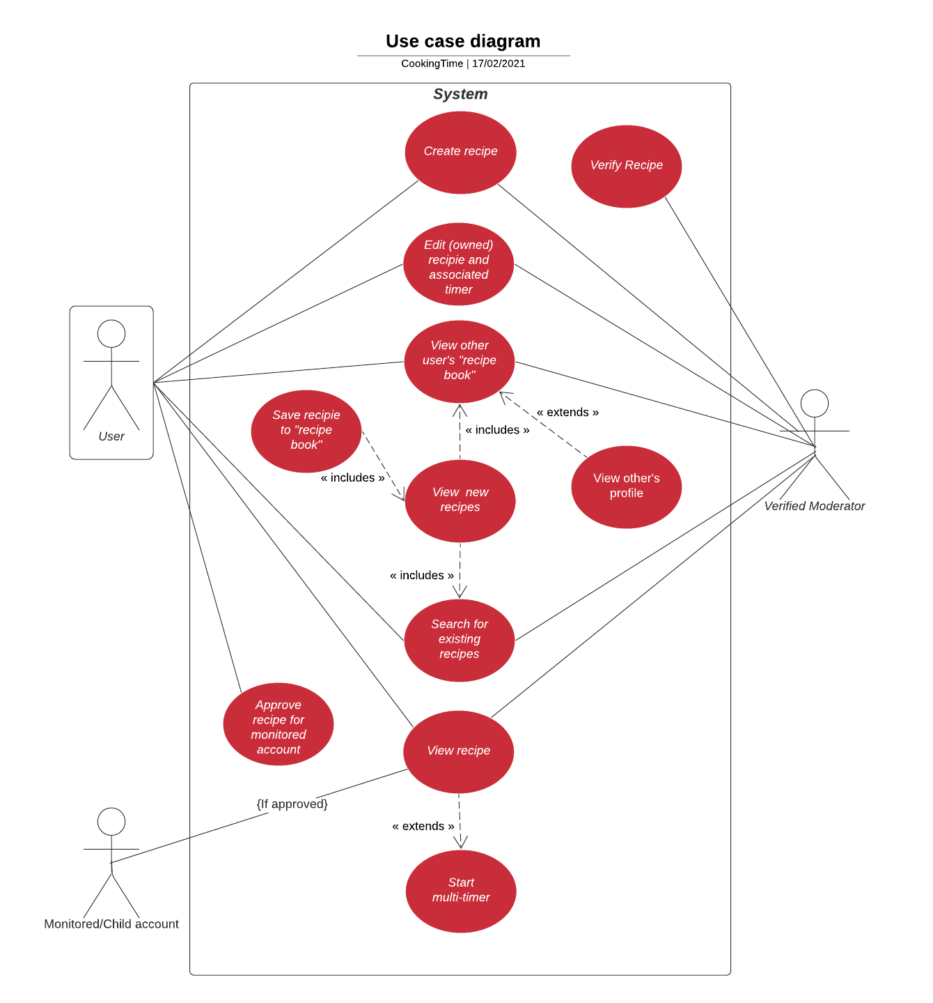
Use Case Diagram
(Default) User
Monitored/Child account (Created under default user)
Can only access recipes authorized by guardian user account
Verified Moderator
Can “verify” recipes, endorsing them
Notes:
Here we can see the use cases of the application. The types of users are: default users, a monitored (or child) account, and a verified moderator.
A monitored account is created under one default user, and can only access recipes authorized by its guardian user account. This could be a parent of a child with a peanut allergy that wants to pre-vet allergies, or a guardian of a person with dementia who forgets they need to eat gluten free.
Verified users are like social media checkmarked users - meaning they and their recipes are endorsed as trusted/professional chefs

Slide 6
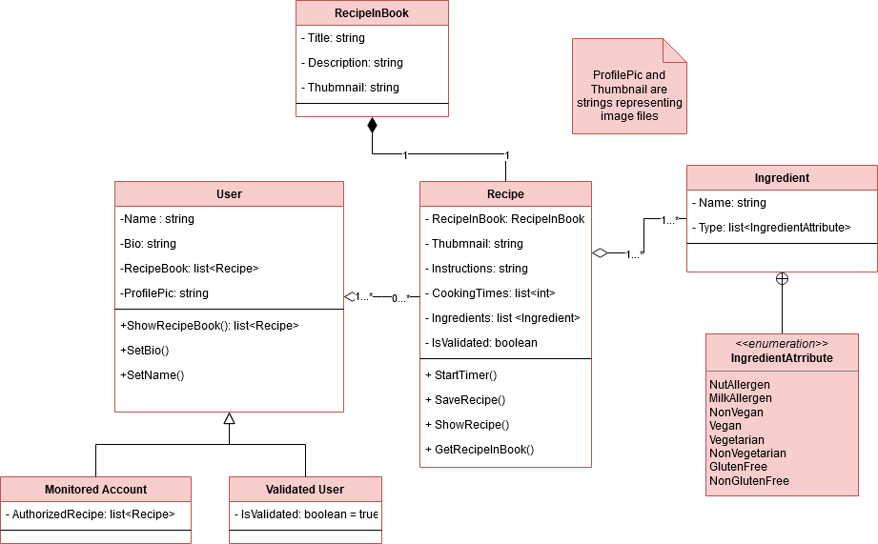
Class Diagram
Notes:
DRAFT
Here’s an initial Class diagram.
Monitored and Verified users are child classes of User.
A thumbnail class for Recipe is RecipeInBook

Slide 7
External Design - Wireframes
Notes:
I’ve made wireframes for all intended screens of the application.

Slide 8
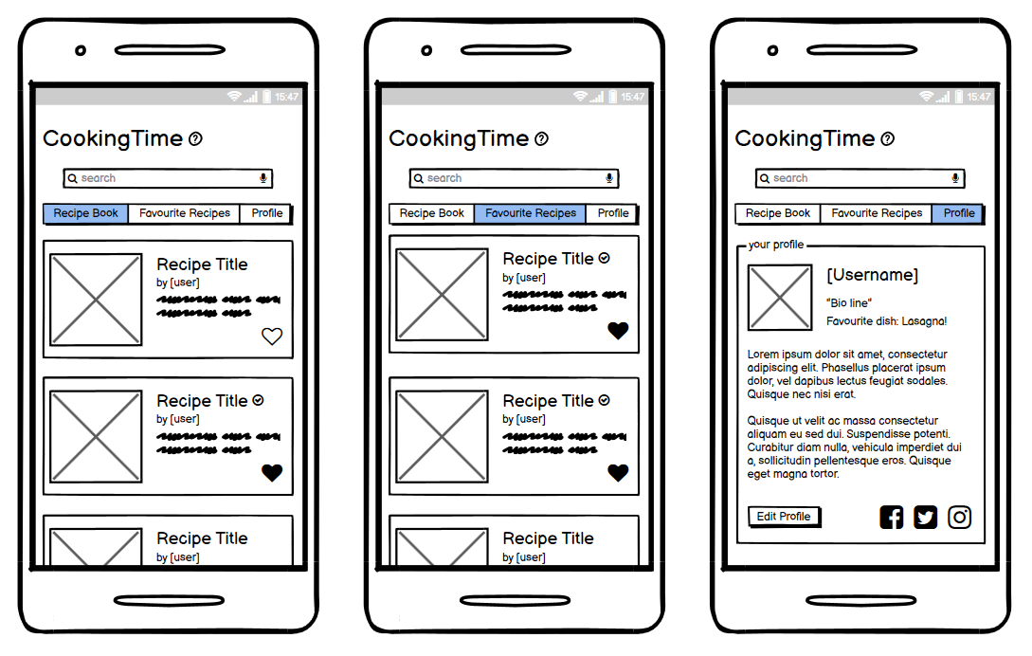
User Home Page
Notes:
The User,
After any loading screens,
Will be taken to this home page with three bars
Recipe book – Recipes which the user has made or saved
Favourite Recipes – Recipes that have been “liked”
And
Profile, where a short bio and external links can be found

Slide 9
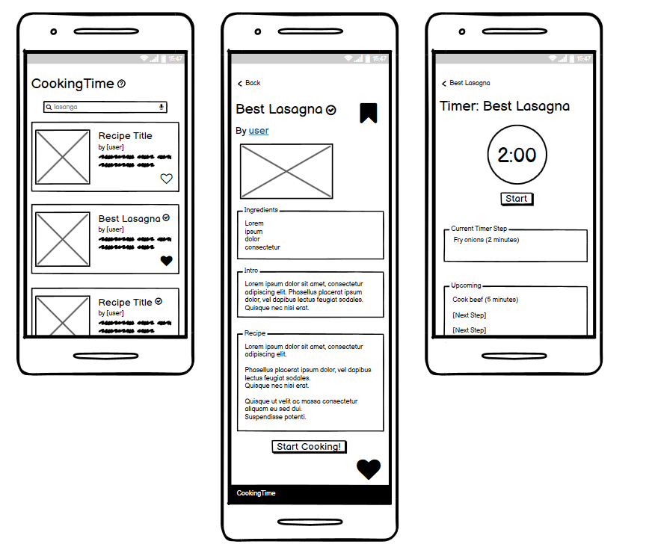
Searching for a recipe, Selecting a recipe, Starting a timer

Slide 10
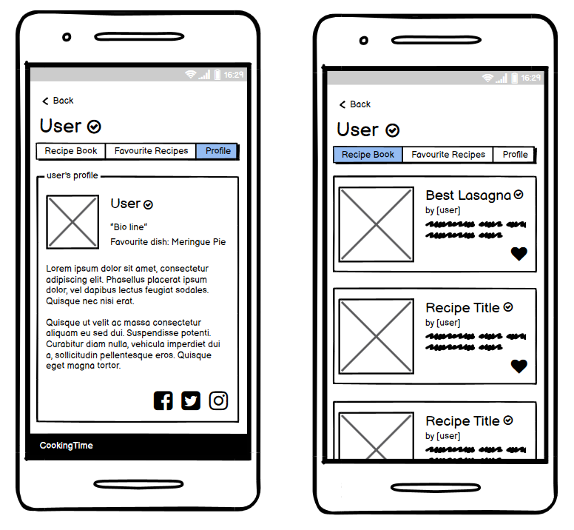
Other user’s page

Slide 11
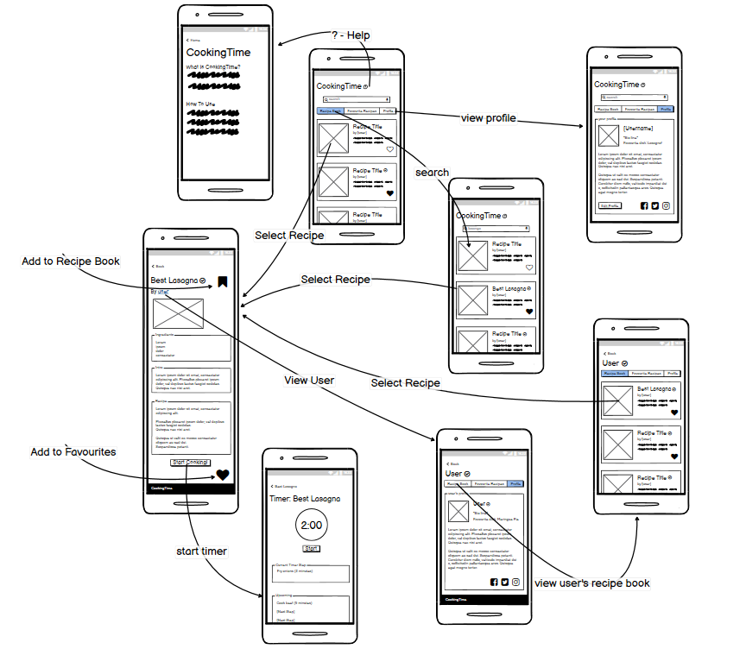
Storyboard -User Paths

Slide 12
Data

Slide 13
Proposed use of Data persistence
Recipes are created and stored
Users have associated recipes

Slide 14
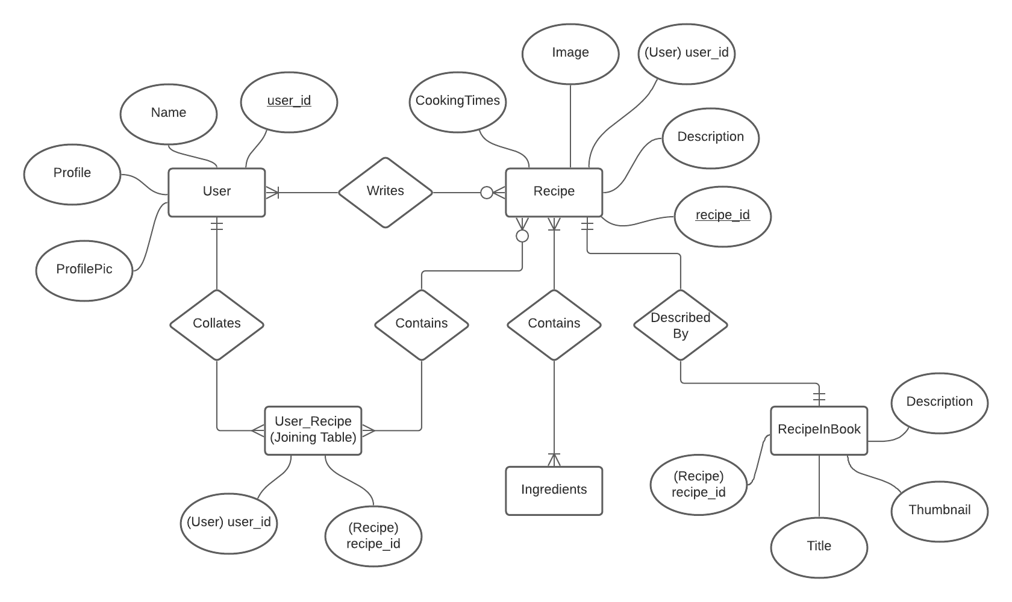
Entity Relationship model
Notes:
Need to check the implied database works with the class model and that works with what I’m making

Slide 15
Exploration of possible forms of persistence in the mobile domain
Chosen method: Local Database with key-pair values using Room and SQLite
Notes:
https://developer.android.com/training/data-storage/room#java

Slide 16
APIs

Slide 17
Proposed use of additional Frameworks
Spoonacular API
https://spoonacular.com/food-api
Food and Grocery Database API
https://developer.edamam.com/food-database-api
Both APIs include Natural Language Processing (NLP)
This detect things such as a recipe with pecans needing to be marked as including nuts

Slide 18
Perceived Challenges
Timers are difficult
they shouldn’t stop if the app is exited
This can be done through services

Slide 19
Additional
Could further the social media aspect – add comments, tags and like counters to recipes
Users have secure (encrypted) login/passwords

Slide 20
Any Questions?
This has been: CookingTime, an integrated recipe book and multi-timer application

